Slide 1
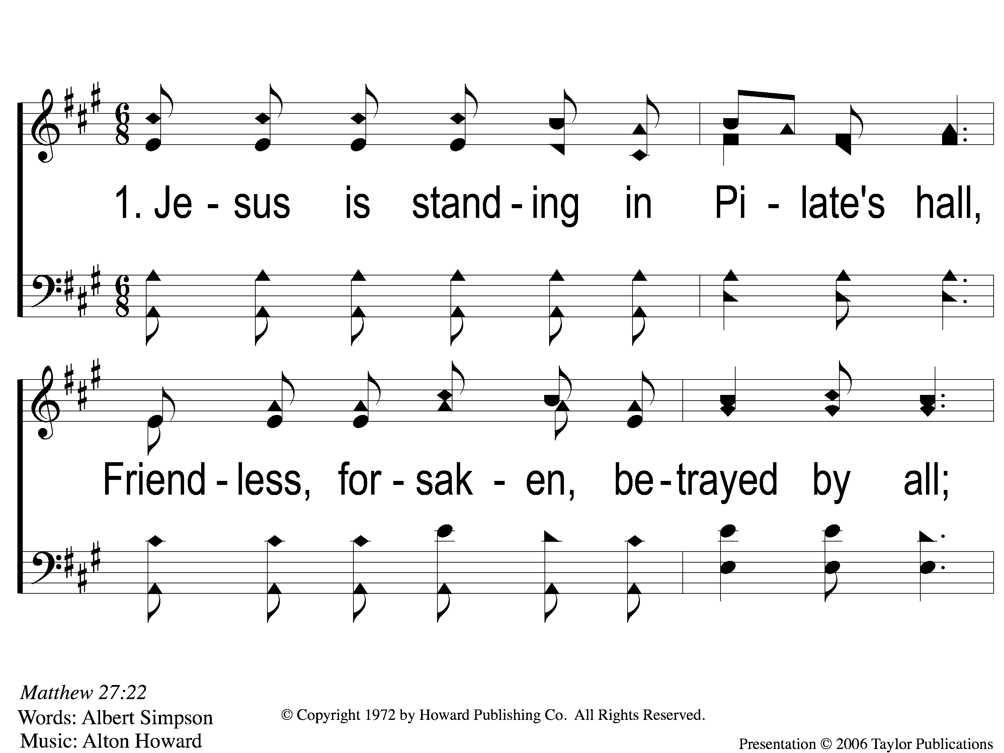
1-1 What Will You Do With Jesus
What Will You Do With Jesus?
A
ePraise Hymn Presentation ©2005 by Taylor Publications

Slide 2
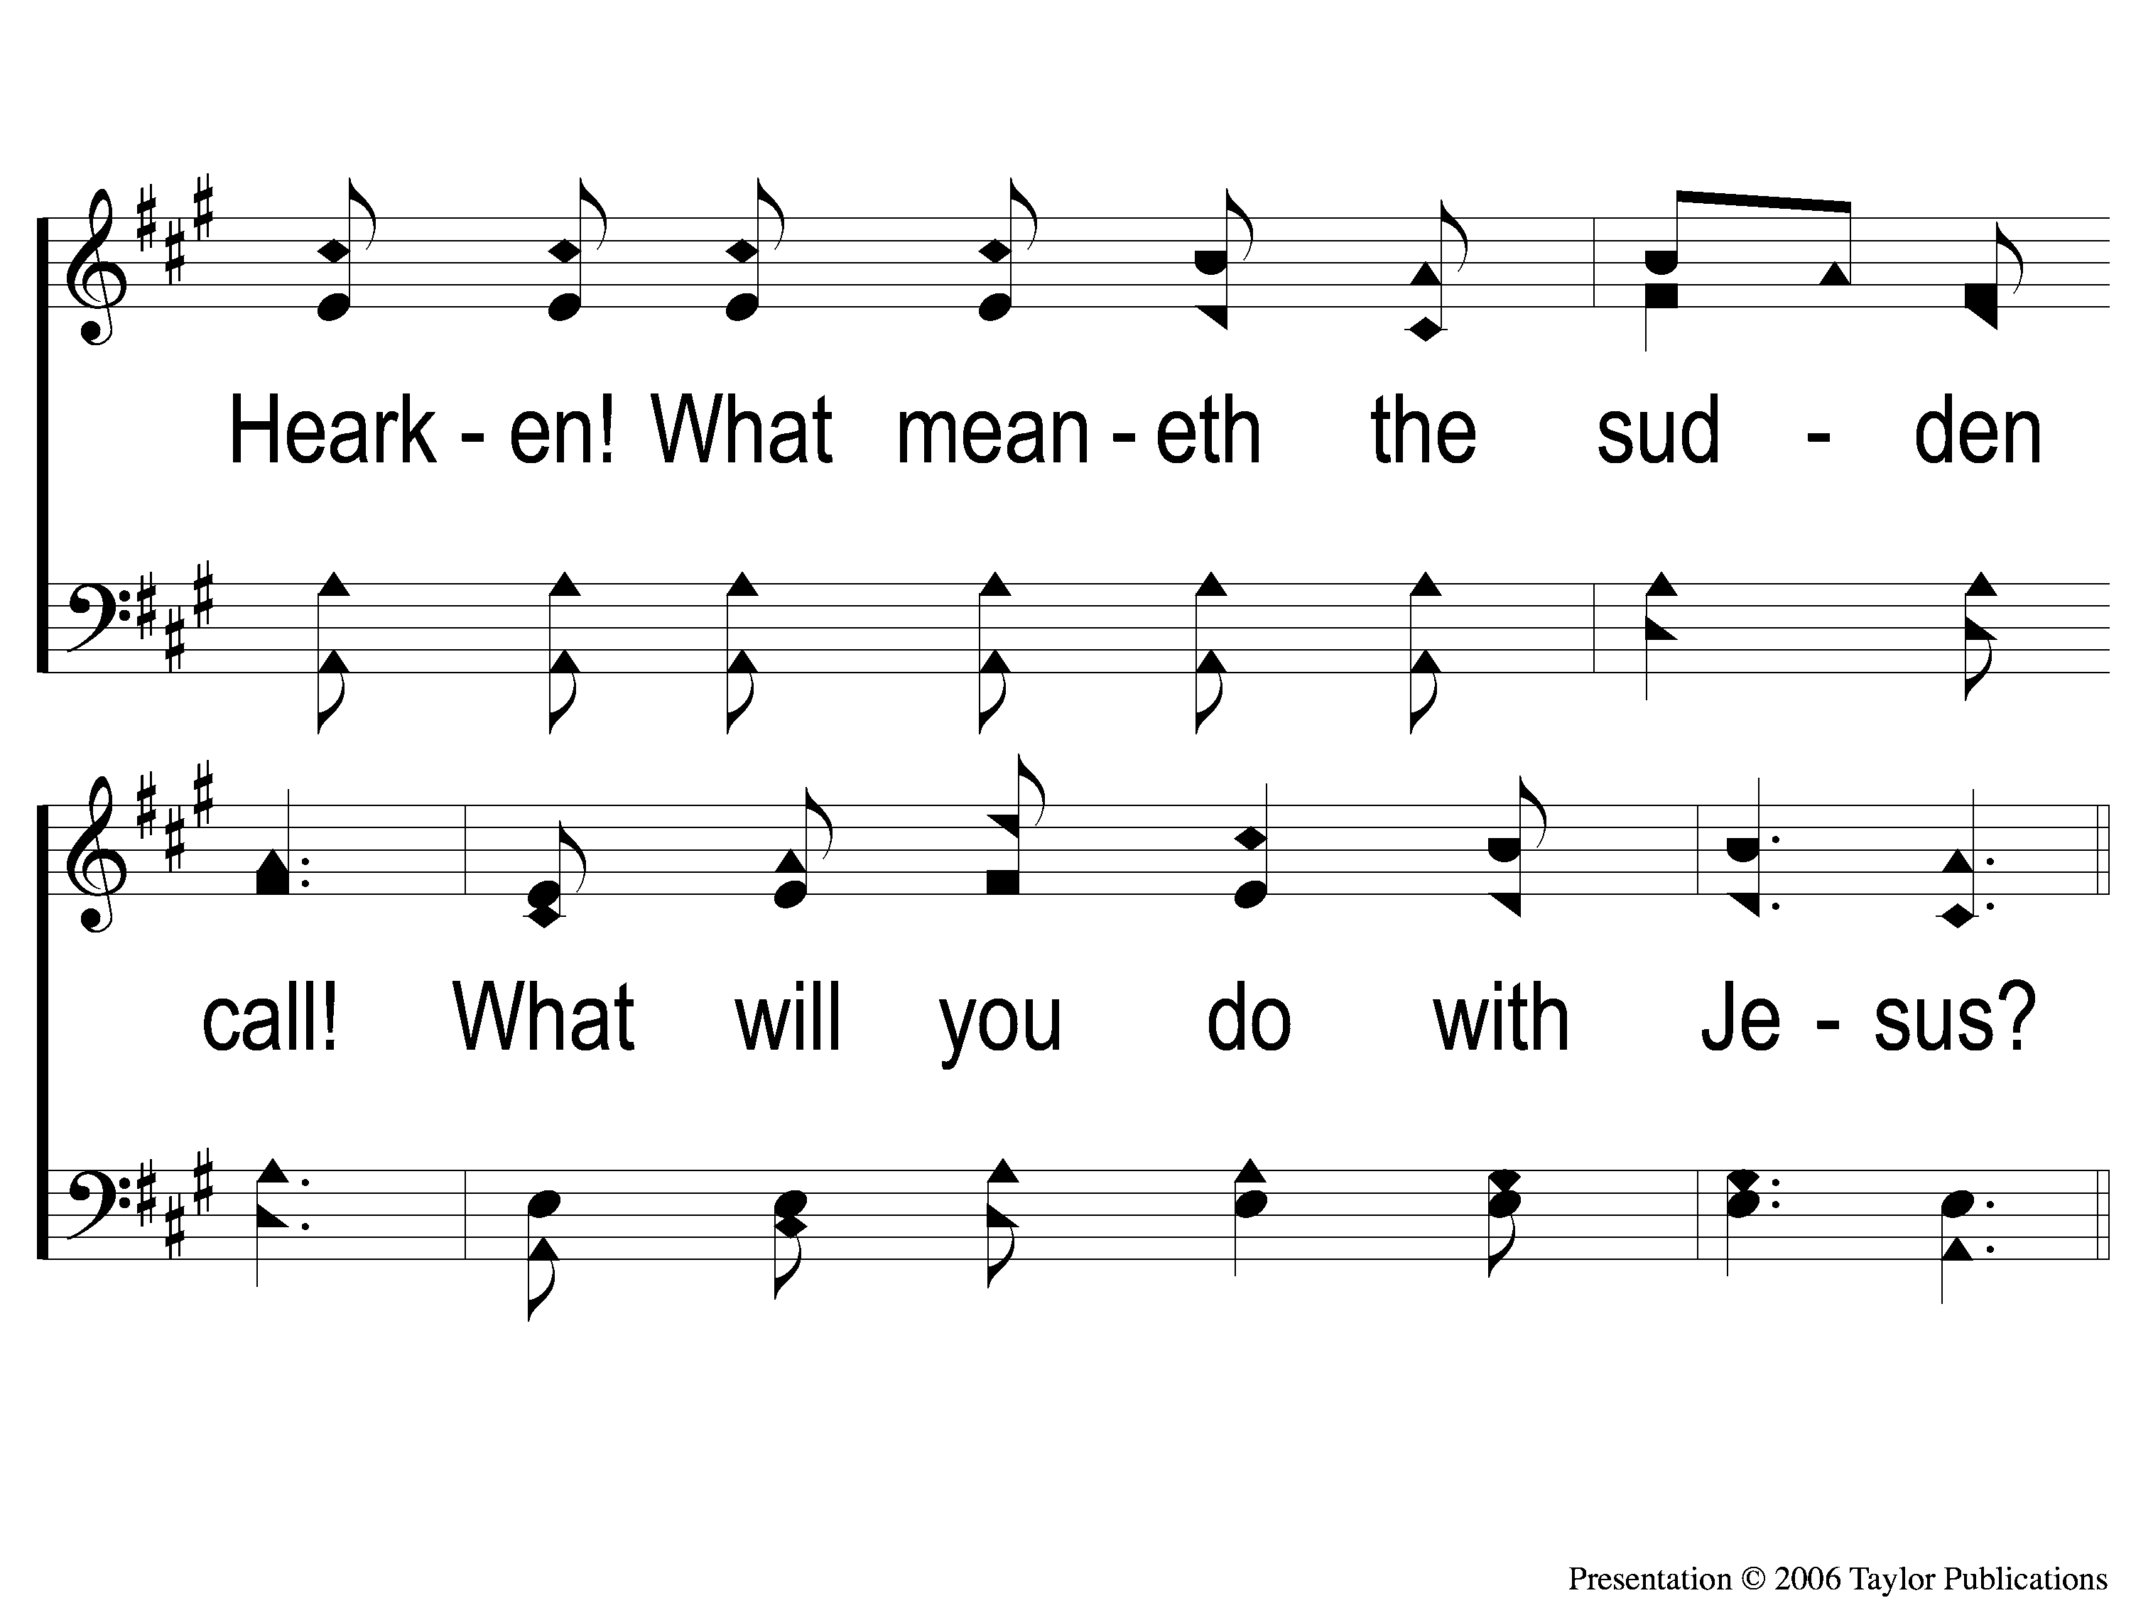
1-2 What Will You Do With Jesus
What Will You Do With Jesus?
A

Slide 3
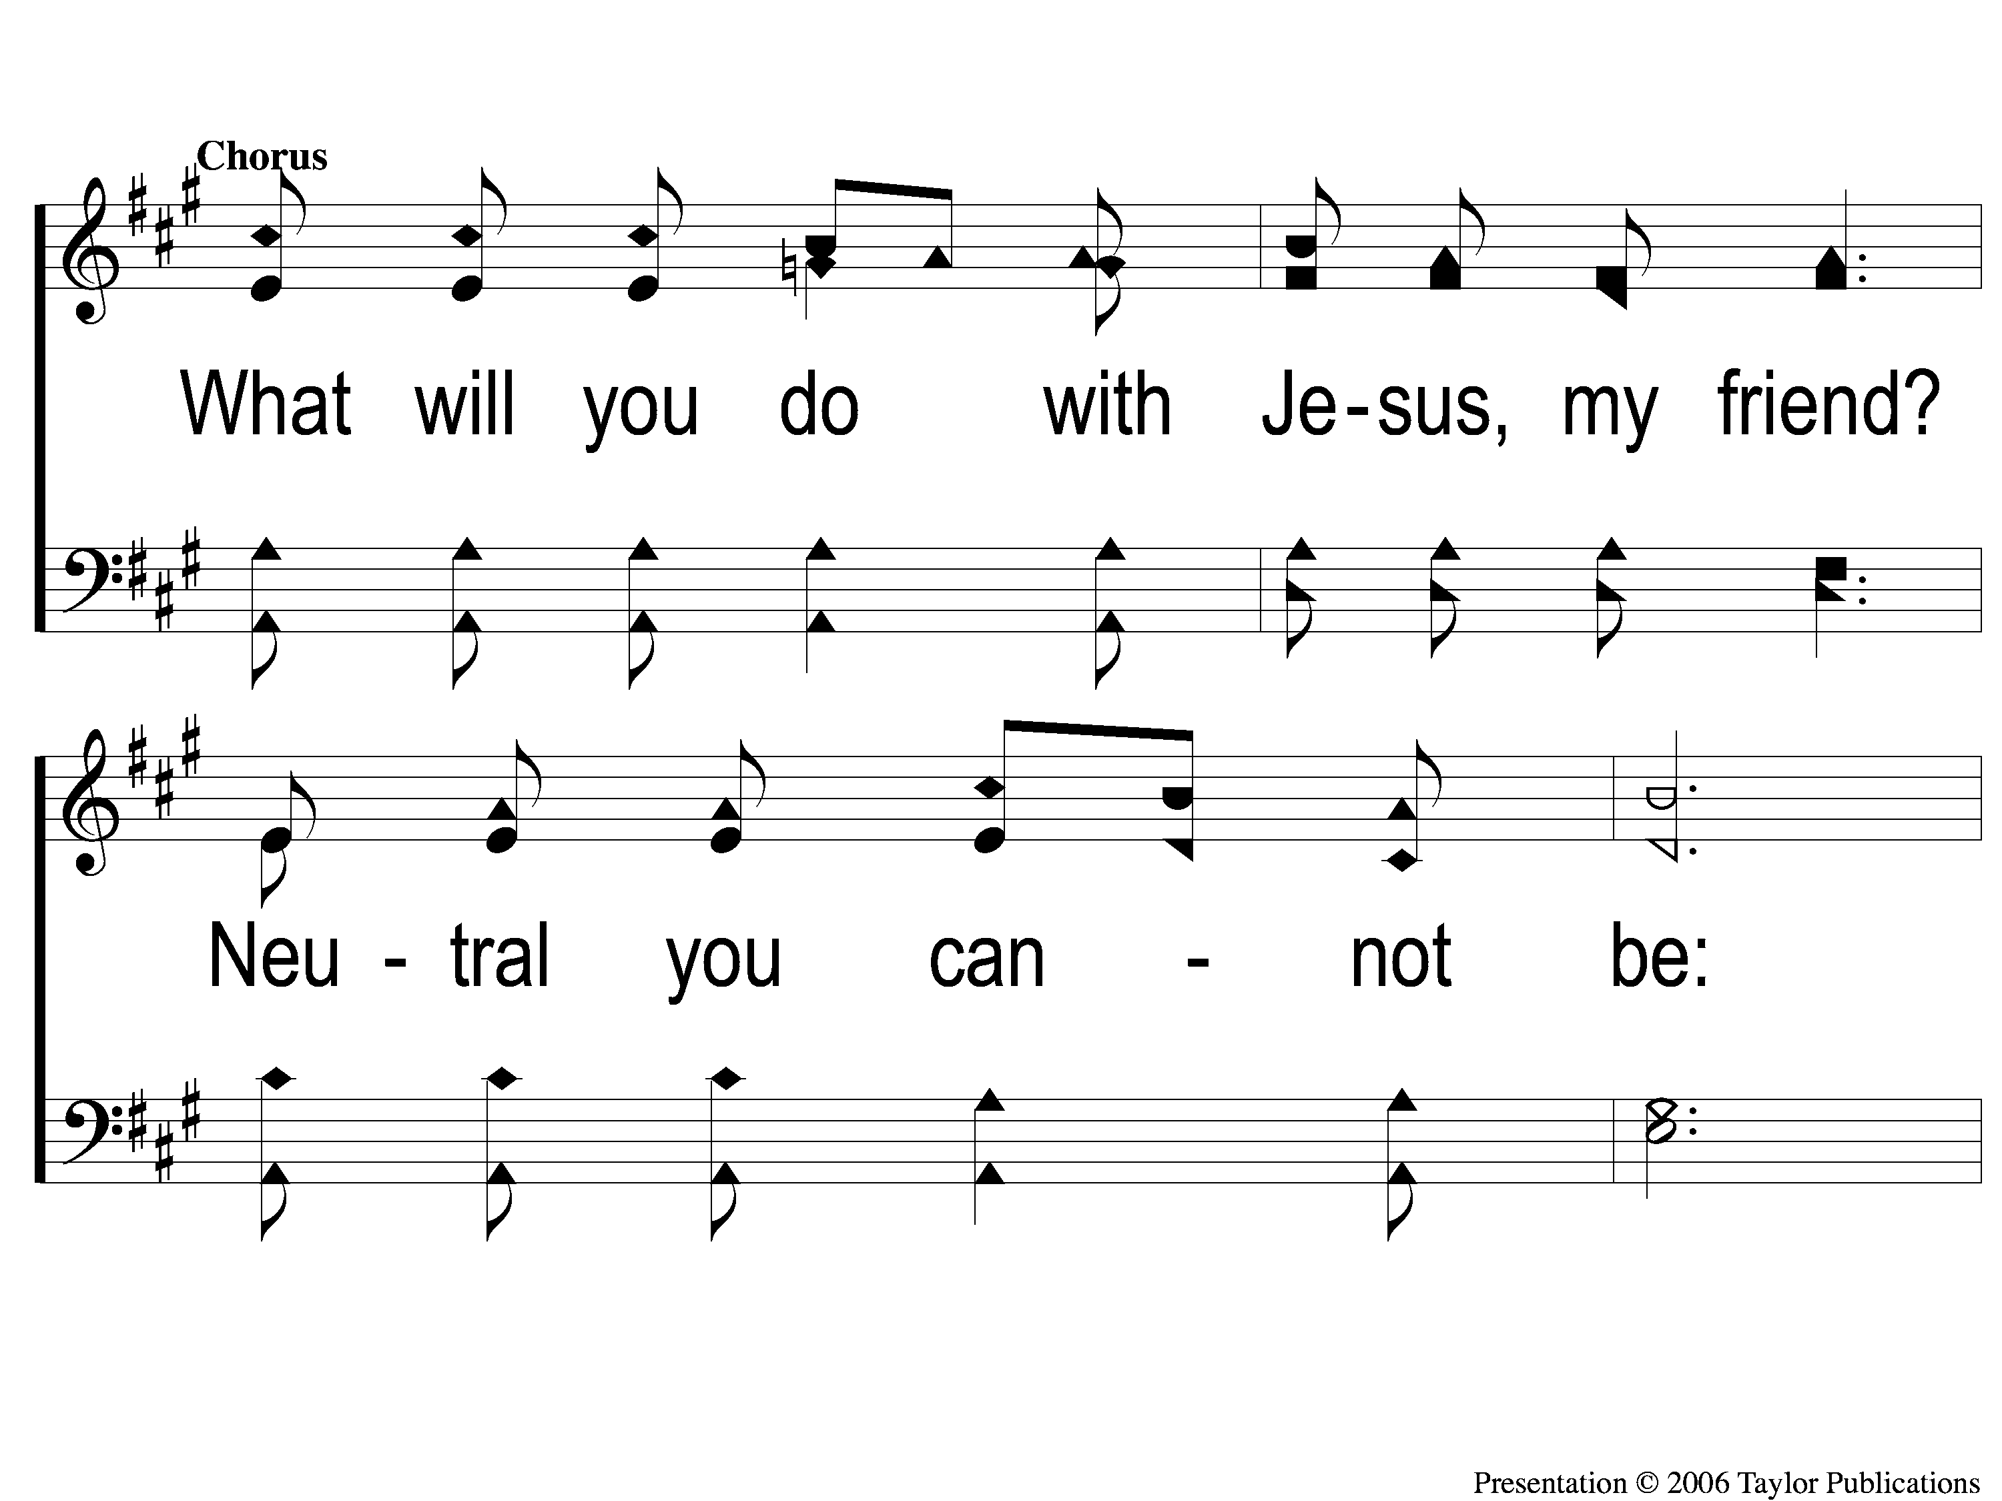
C-1 What Will You Do With Jesus
What Will You Do With Jesus?
A
ePraise Hymn Presentation ©2005 by Taylor Publications

Slide 4
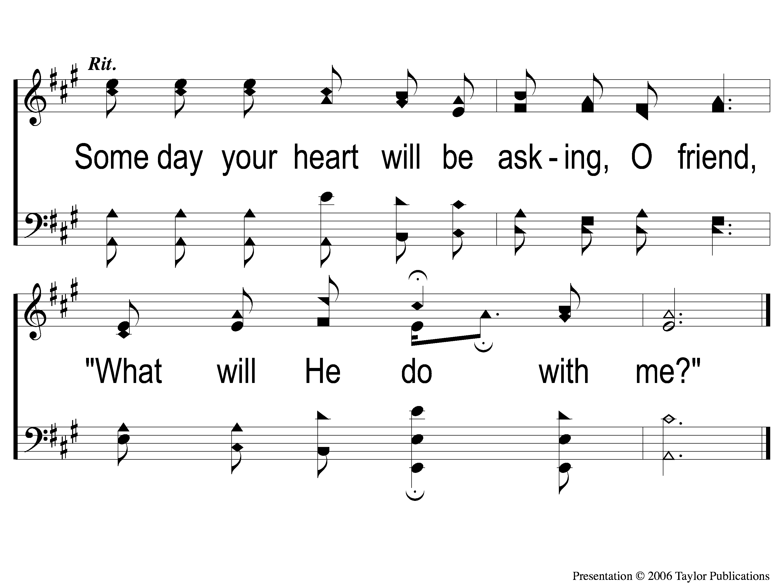
C-2 What Will You Do With Jesus
What Will You Do With Jesus?
A
ePraise Hymn Presentation ©2005 by Taylor Publications

Slide 5
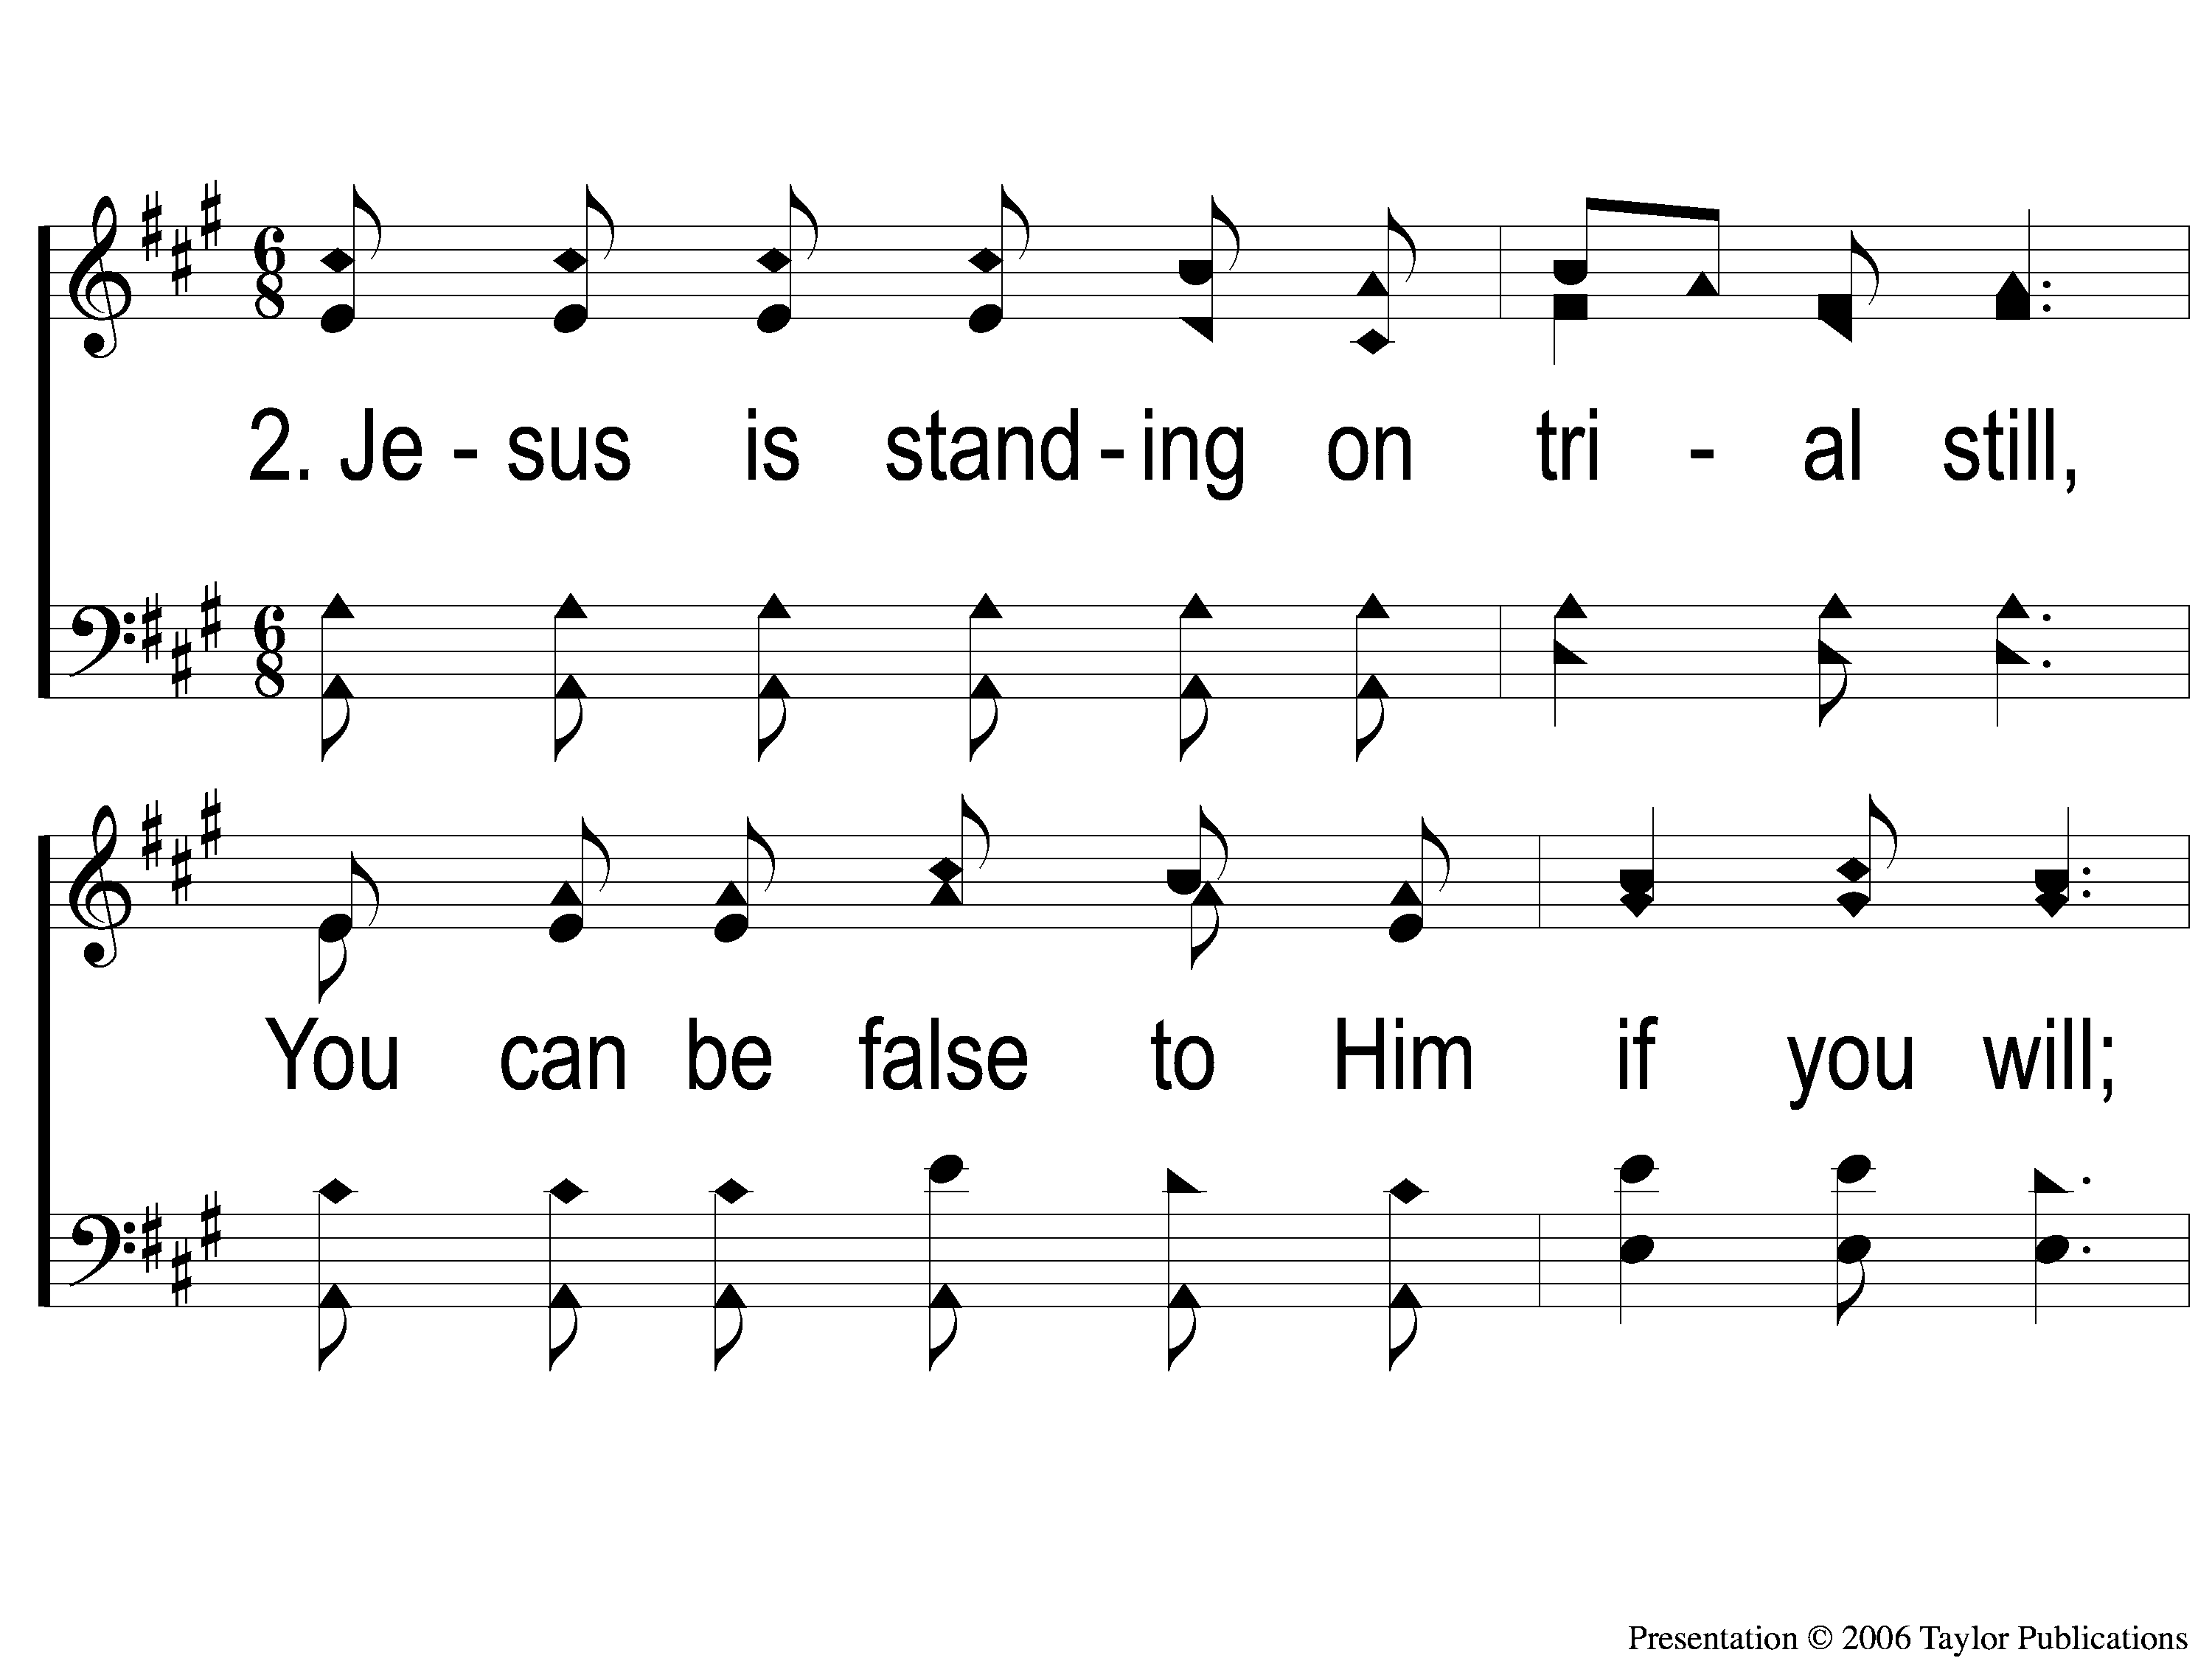
2-1 What Will You Do With Jesus
What Will You Do With Jesus?
A
ePraise Hymn Presentation ©2005 by Taylor Publications

Slide 6
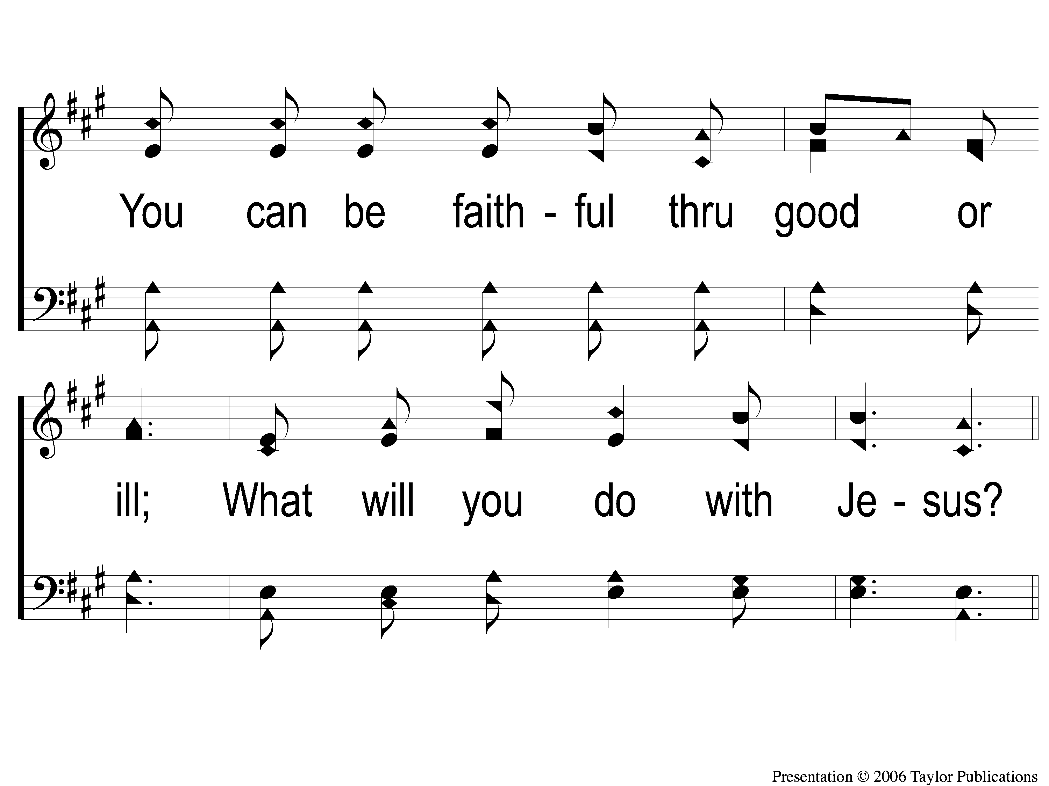
2-2 What Will You Do With Jesus
What Will You Do With Jesus?
A
ePraise Hymn Presentation ©2005 by Taylor Publications

Slide 7
C-1 What Will You Do With Jesus
What Will You Do With Jesus?
A
ePraise Hymn Presentation ©2005 by Taylor Publications

Slide 8
C-2 What Will You Do With Jesus
What Will You Do With Jesus?
A
ePraise Hymn Presentation ©2005 by Taylor Publications

Slide 9
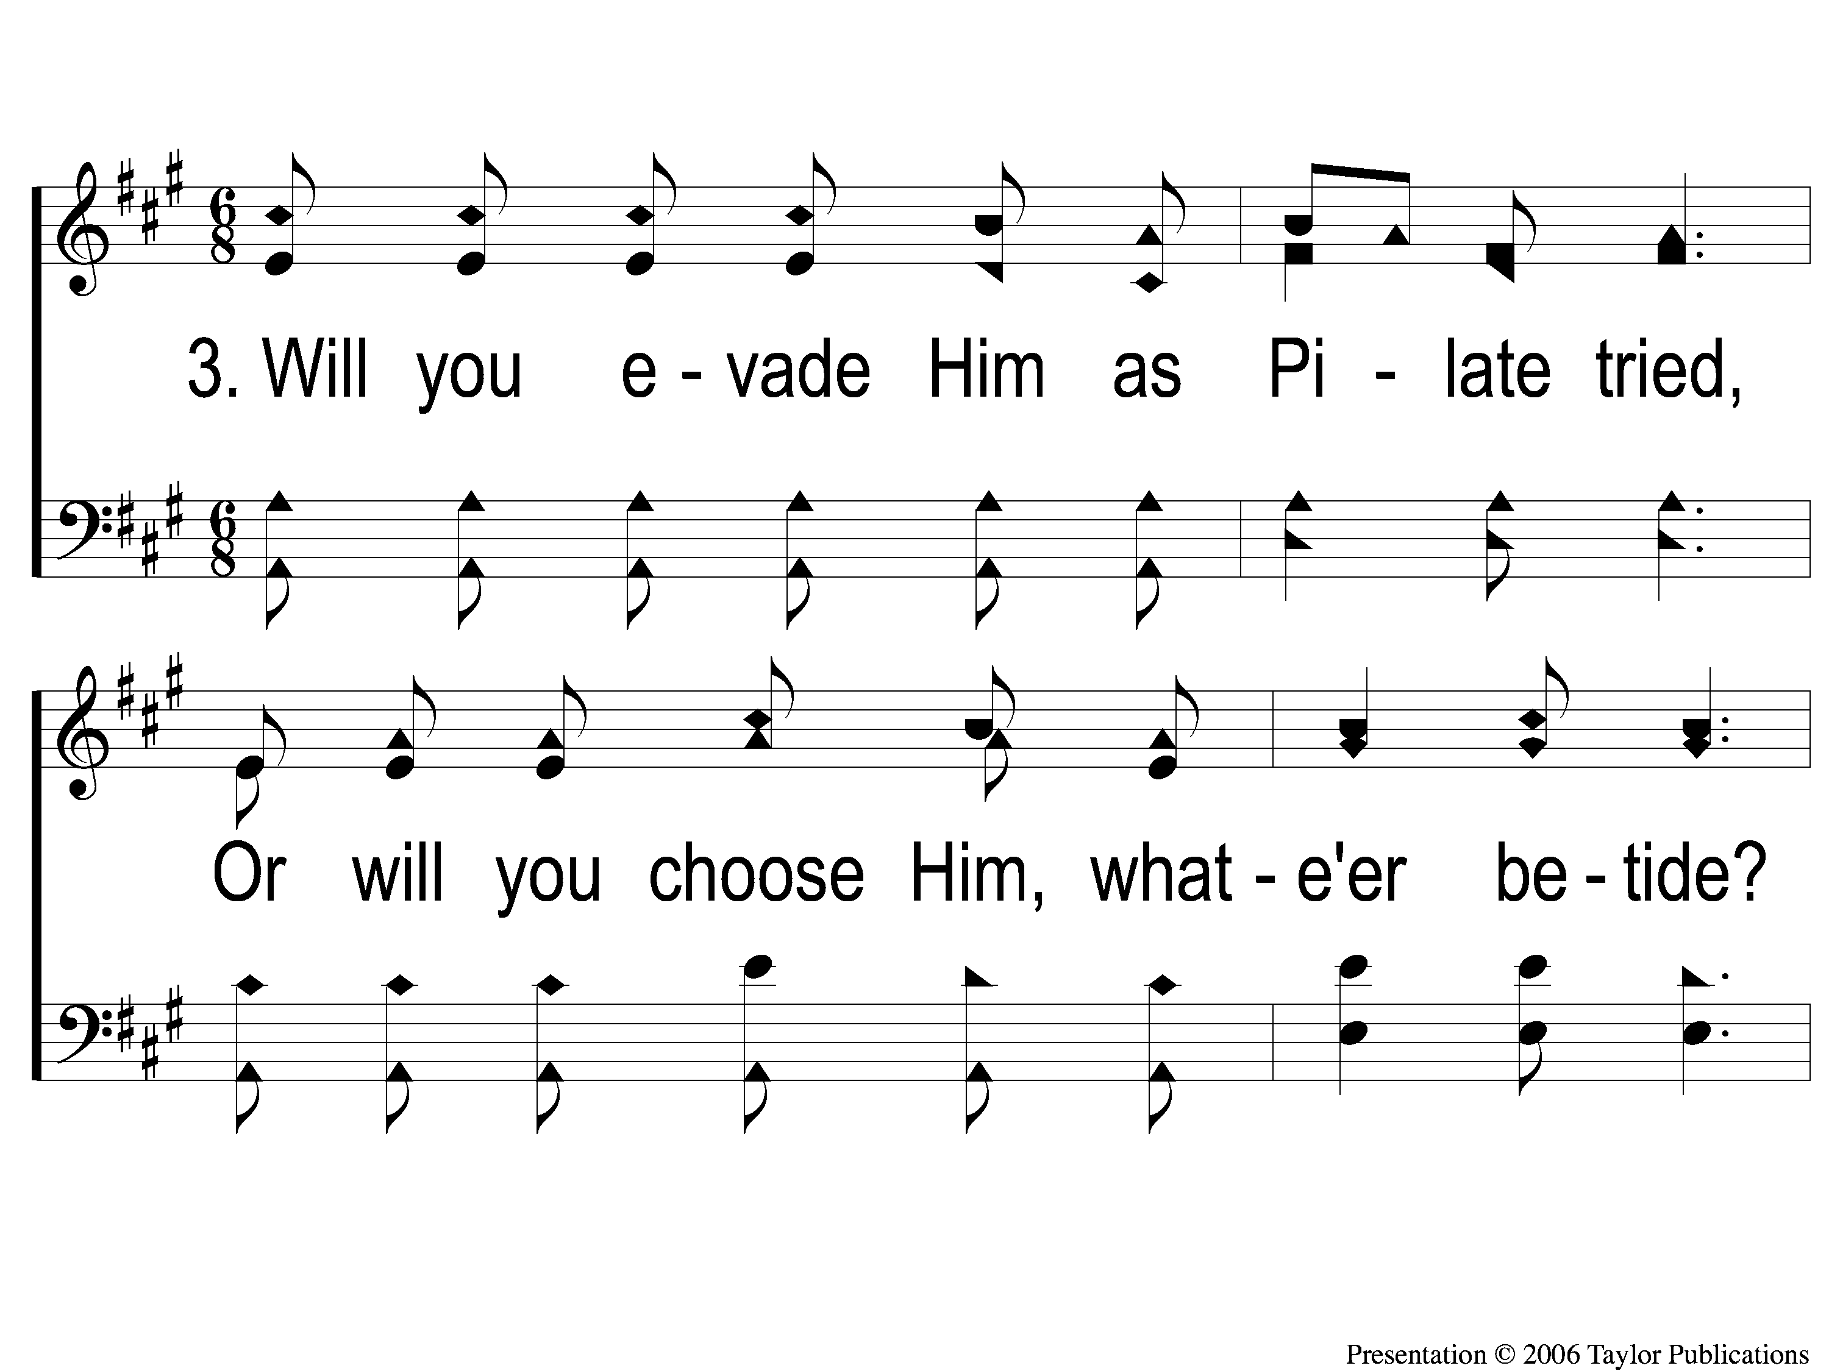
3-1 What Will You Do With Jesus
What Will You Do With Jesus?
A
ePraise Hymn Presentation ©2005 by Taylor Publications

Slide 10
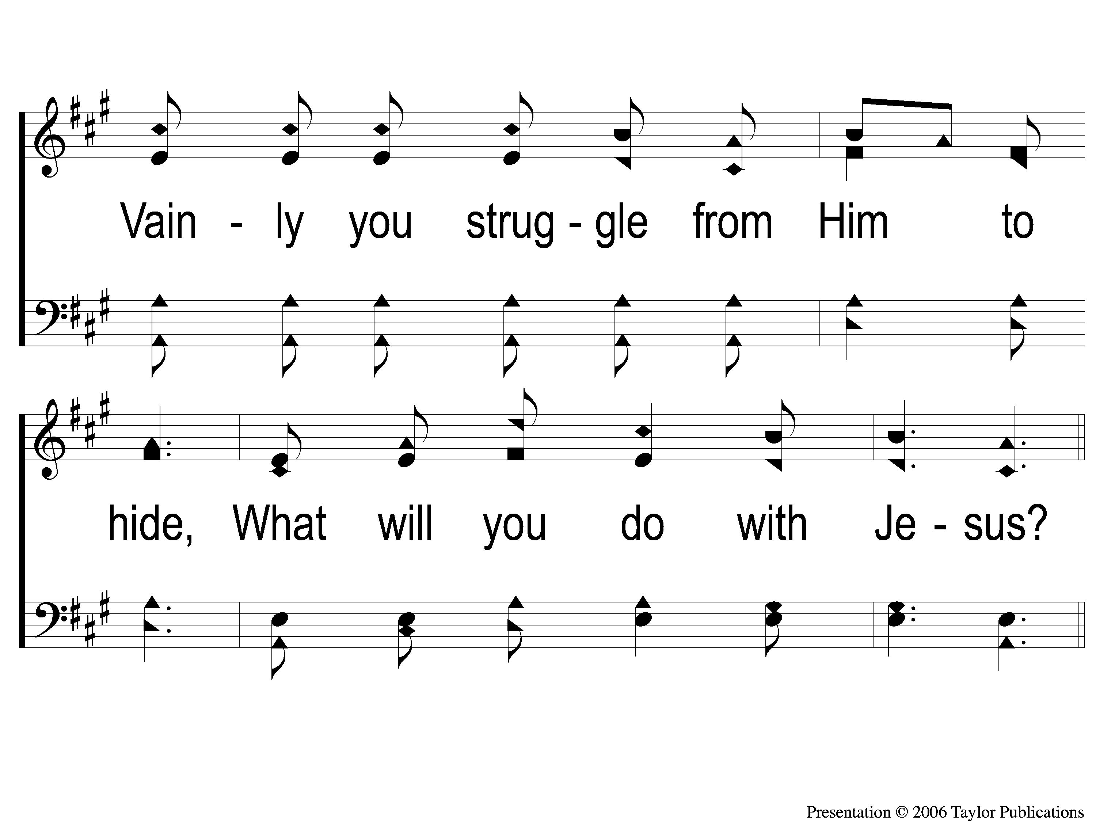
3-2 What Will You Do With Jesus
What Will You Do With Jesus?
A
ePraise Hymn Presentation ©2005 by Taylor Publications

Slide 11
C-1 What Will You Do With Jesus
What Will You Do With Jesus?
A
ePraise Hymn Presentation ©2005 by Taylor Publications

Slide 12
C-2 What Will You Do With Jesus
What Will You Do With Jesus?
A
ePraise Hymn Presentation ©2005 by Taylor Publications

Slide 13
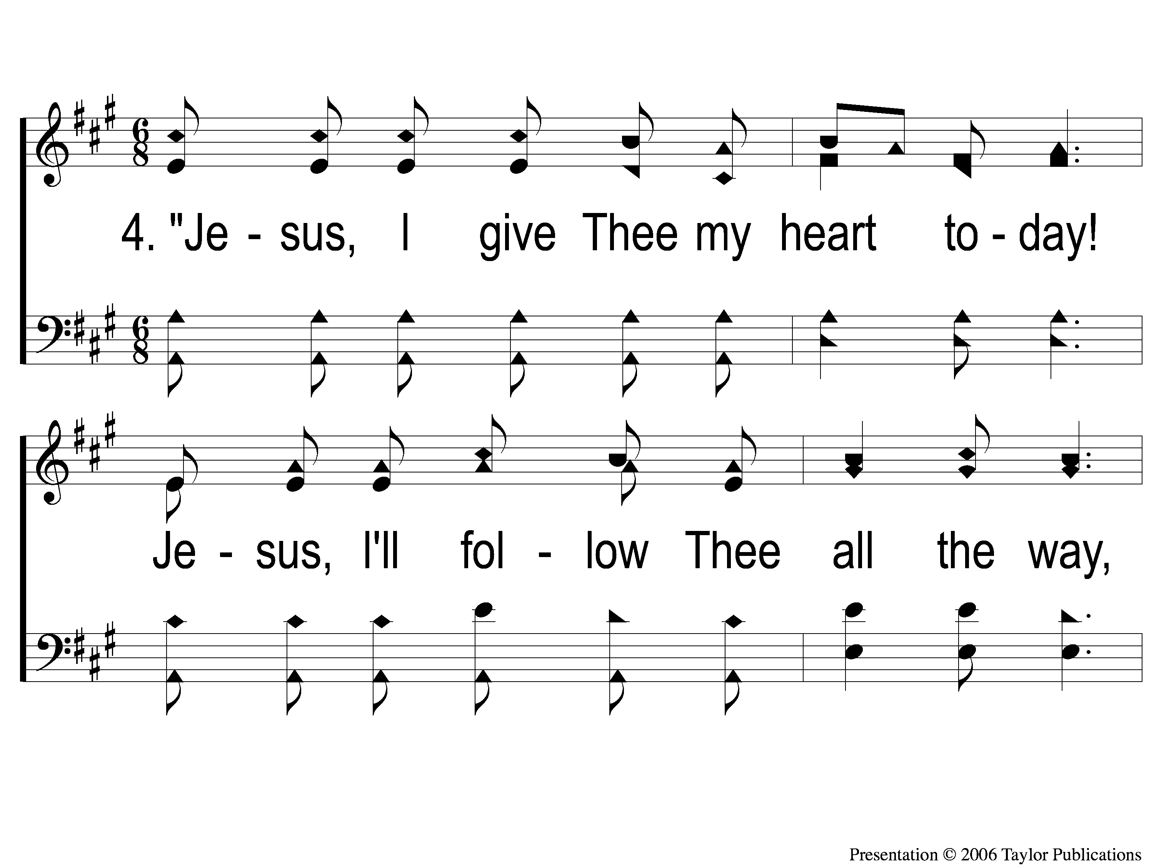
4-1 What Will You Do With Jesus
What Will You Do With Jesus?
A
ePraise Hymn Presentation ©2005 by Taylor Publications

Slide 14
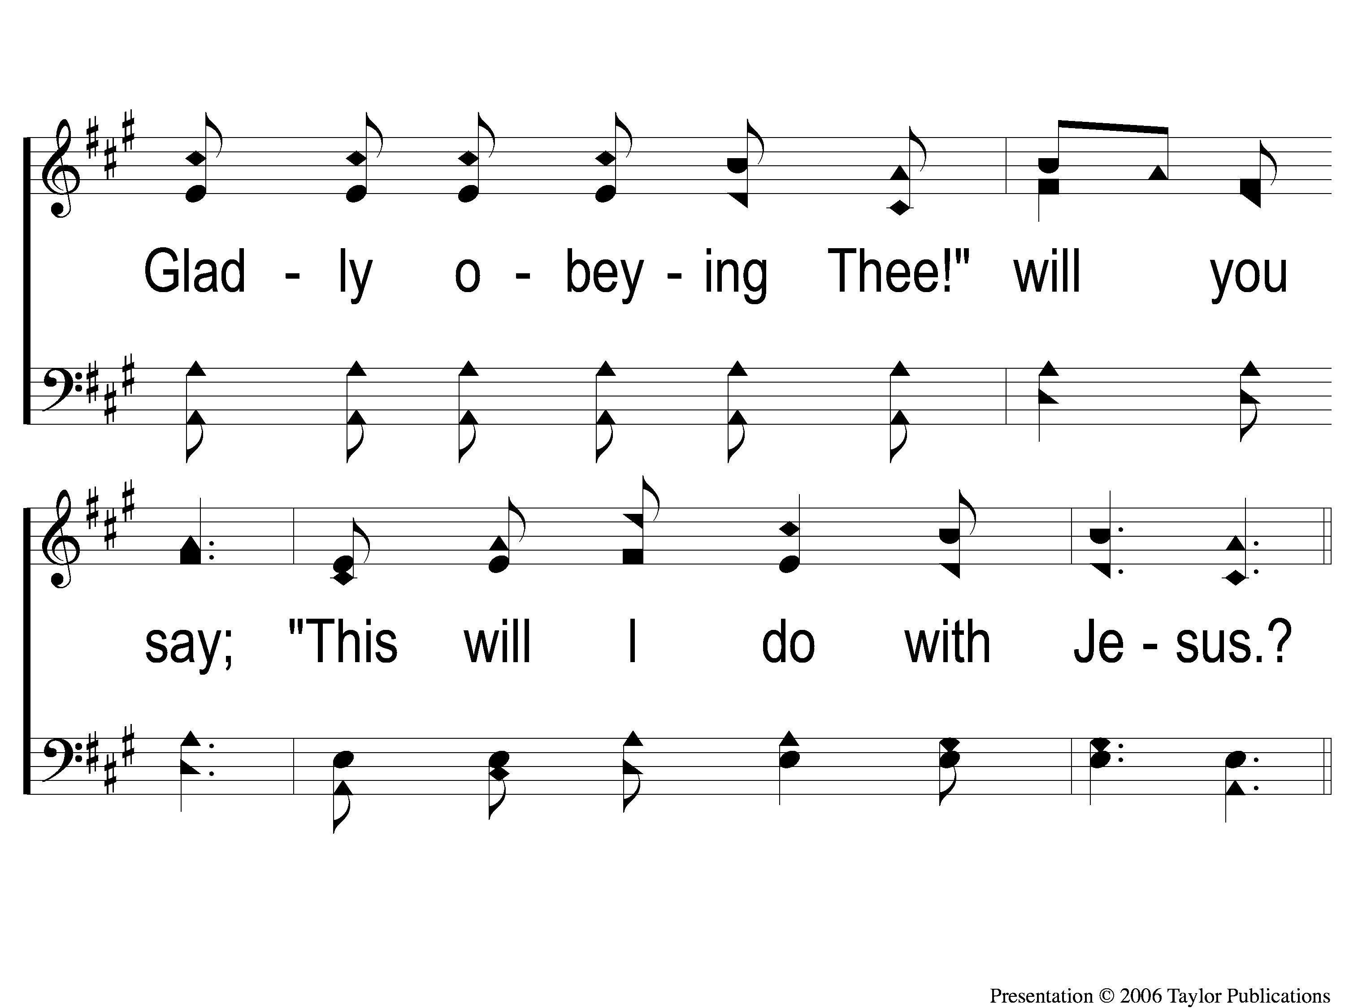
4-2 What Will You Do With Jesus
What Will You Do With Jesus?
A
ePraise Hymn Presentation ©2005 by Taylor Publications

Slide 15
C-1 What Will You Do With Jesus
What Will You Do With Jesus?
A
ePraise Hymn Presentation ©2005 by Taylor Publications

Slide 16
C-2 What Will You Do With Jesus
What Will You Do With Jesus?
A
ePraise Hymn Presentation ©2005 by Taylor Publications

